Slide 1


Slide 2
Quantitative Management Modeling Final Exam
Presented by
Rakhee Moolchandani
rmoolcha@kent.edu

Slide 3
OBJECTIVE
The goal of the assignment is to form 4 groups.
Each group must have no less or no more than three students.
The objective is to maximize the chance that each group will do well on a class project.

Slide 4
ASSUMPTIONS
Create four groups for the final assignment of Quantitative Management Modeling Class.
There are 12 students in the class.
Create no more that 4 groups with 3 students in each group.

Slide 5
CHOICE OF FACTORS
GPA of all the students
Previous Academic Background
Any relative Work Experience

Slide 6
MEASURES AND DATA COLLECTION
Factors | Measurements | Data Collection
Grade Point Average (GPA) | Student’s Undergraduate degree GPA | Graduate Admission Office
Academic Background | Undergraduate degree (Technical or Non-Technical) | Graduate Admission Office
Experience | Relative Work Experience | Graduate Admission Office

Slide 7
DATA (GENERATED RANDOMLY)
Student | GPA (4) | Experience(in years) | Academic Background (.6/.4)
1 | 3.80 | 9 | 0.6
2 | 3.81 | 5 | 0.6
3 | 3.18 | 9 | 0.4
4 | 3.57 | 5 | 0.6
5 | 3.65 | 9 | 0.4
6 | 3.17 | 6 | 0.6
7 | 3.42 | 7 | 0.6
8 | 3.13 | 7 | 0.4
9 | 3.89 | 6 | 0.4
10 | 3.91 | 5 | 0.6
11 | 3.25 | 5 | 0.4
12 | 3.85 | 7 | 0.4

Slide 8
Objective Function: Maximize the GPA factor.
Decision Variables:
Create 48 decision variables.
12 decision variables for each group.
Constraints :
Group Size should be equal to 3.
One student per group.
Average group experience must be above 20 per group.
Average Academic background value must be above 1.4 per group.
Average GPA per group must be 10.6.

Slide 9
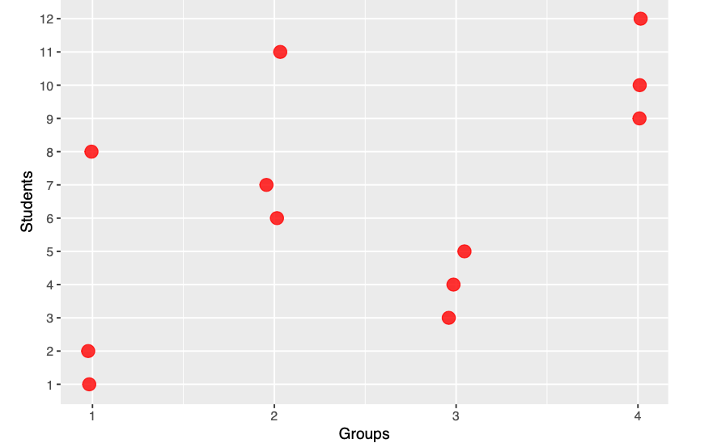

GROUPS FORMED

Slide 10
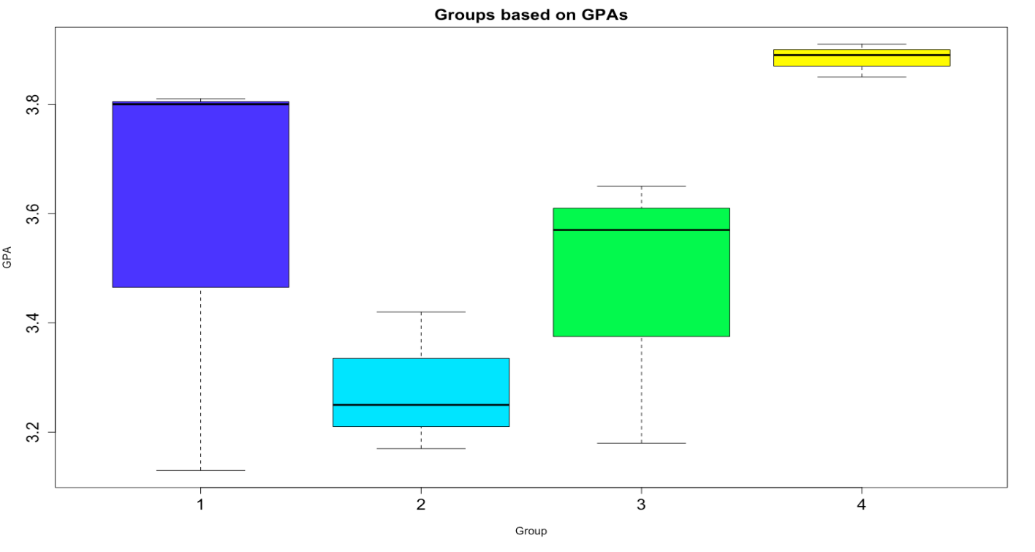
GROUPS BASED ON GPA

Slide 11
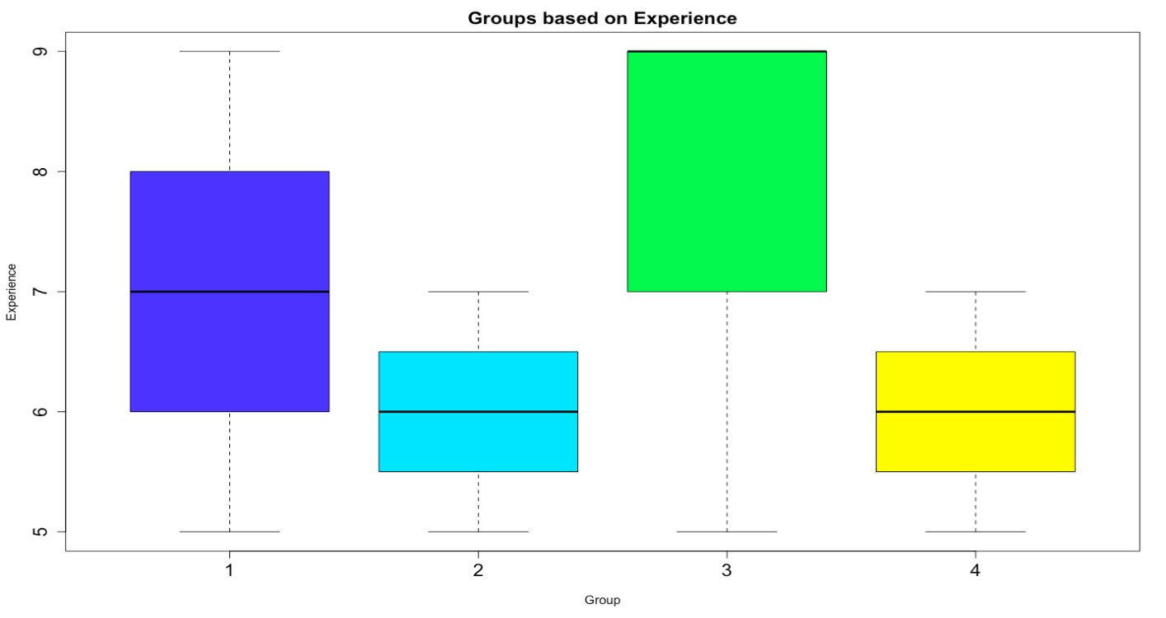
GROUPS BASED ON EXPERIENCE

Slide 12
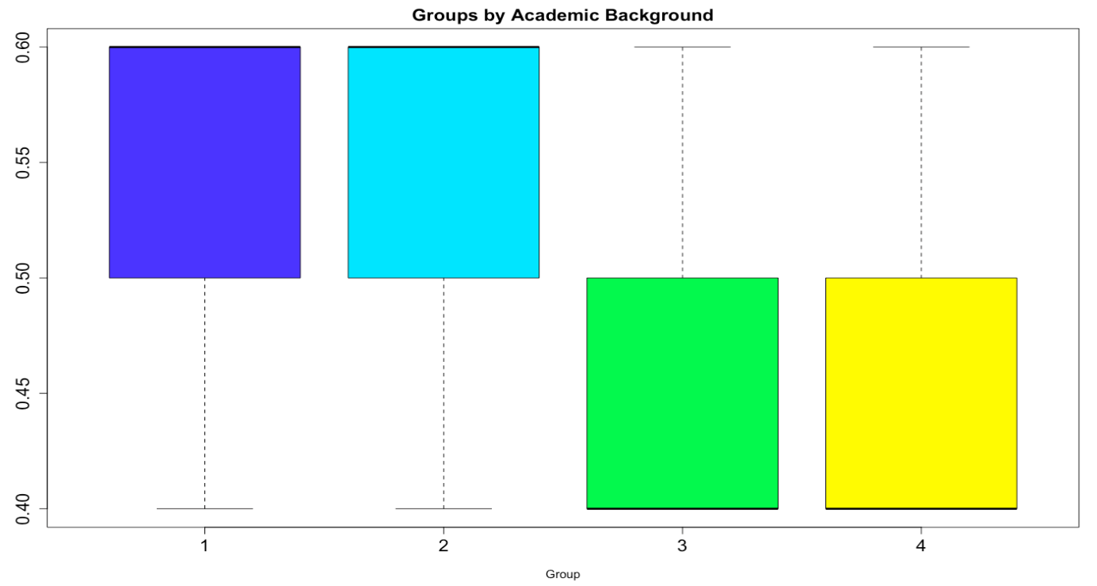
GROUPS BASED ON ACADEMIC BACKGROUND

Slide 13
LIMITATIONS
Assumptions on factors leading to success in making groups
Randomly generated dataset

Slide 14
Thank You!
Kent.edu

